Slide 1
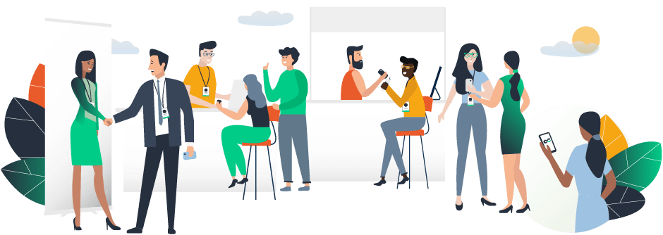
HOW TO GUIDE

Slide 2
ACCESS THE APP
LOGIN

Slide 3
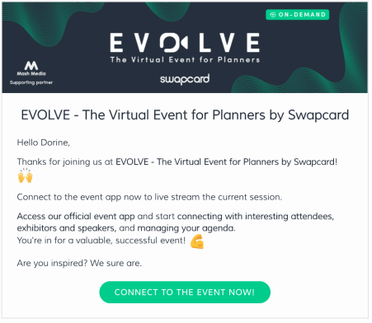
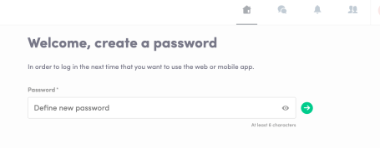
How to login for the first time?
You will receive an email similar to this one with a button redirecting to a login page. Your account is automatically pre-created by the platform after your registered.
A window will then suggest you to create a password for your account.
Note : If you don’t see this email in your mailbox, please check your spam.

Slide 4
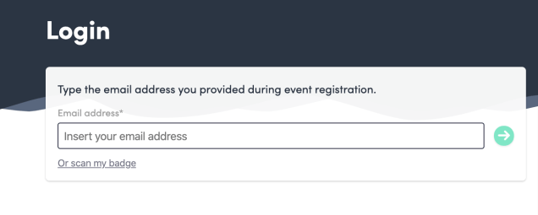
How to login when I already have an account ?
Access to your account on login.swapcard.com Enter the email you used to register to your event and the password you’ve created before. Then, click enter to connect.
Note : If you have forgotten your password after entering your email, click on Send me a magic link. You’ll receive in your mailbox an email to reset your password. If you need any help, please contact support@swapcard.com

Slide 5
AVAILABLE FEATURES
CONTENT FEATURES

Slide 6
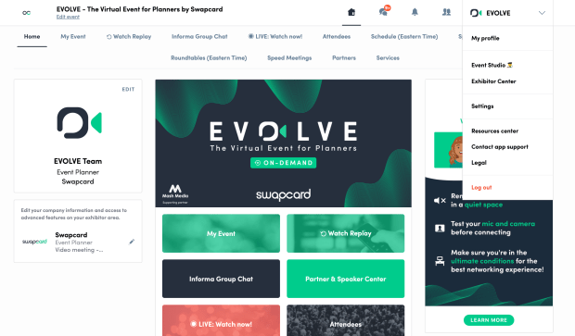
How to edit my profile ? (1/2)
There are two ways for you to access your profile :
On the upper-right corner of your screen, click on My profile.
On the left side of your screen next to your photo, click on Edit.
You’ll be redirected to your profile details.

Slide 7
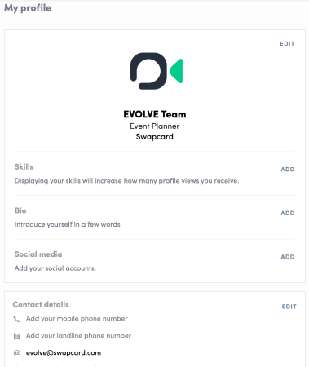
How to edit my profile ? (2/2)
To edit the information on your profile, simply click on the Edit or Add parts depending on which type of information you want to edit.
Here are the information you can edit on your profile :
Personal information
Skills
Biography
Social Media
Contact details
Company

Slide 8
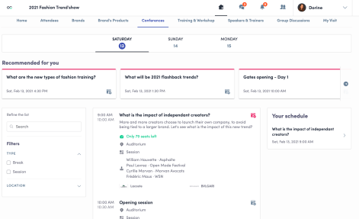
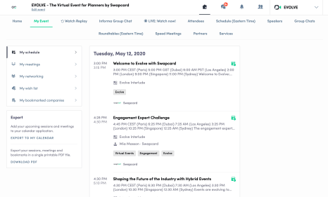
How does the program work ?
The program tab gathers all sessions of the event. You can easily register to sessions by clicking on this logo.
Note : You can define your search by using filters located on the left side of the screen.
The tab of “My Event” allows you to see your own schedule. You can find there the sessions you are interested in, the sponsors and partners you bookmarked, as well as your confirmed meetings. You can export your program by clicking on « Export to my calendar » or « Download PDF ».

Slide 9
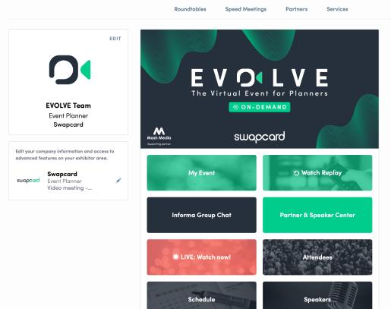
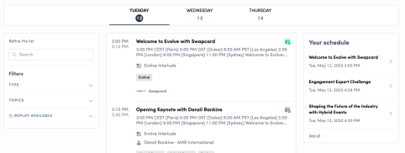
How to access a live streaming session ?
There are two ways to access a live streaming session.
From your Event Home, click on the « Live session » button which should be displayed.
You will get redirected to the current session, or the following one if nothing is happening at that time.
From your Event schedule or My Event tab, click on the current session you want to follow. You are now on the session page where the live session is taking place.

Slide 10
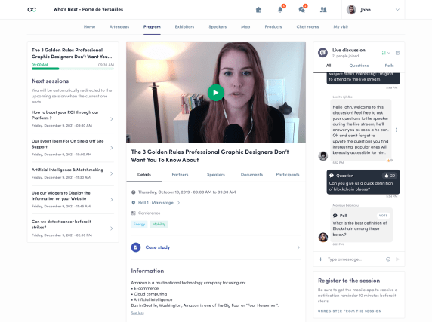
How to follow a live streaming session ?
Less than 24 hours before: a countdown will be added to the session page
As soon as the session begins, the video will be displayed at the top of the session page and will start automatically (except on Safari for which you will have to click on "Play").
You will then be able to watch the video, in full screen mode if you wish, or continue to browse the app while watching the session.

Slide 11
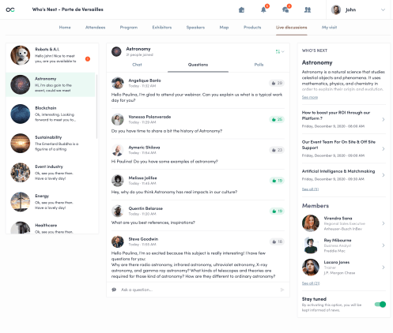
How to interact during a live session?
Thanks to the live discussion, you are now able to speak with other attendees, ask questions to the speakers, and answer to different polls they will create.
React on other people’s messages or delete your message by click on the three dots next to it. Questions will be sorted by upvotes.

Slide 12
What’s the autoplay ?
The autoplay feature is automatically activated when you click on a “live” agenda button.
This features allows a seamless experience when watching sessions since it takes you from one session to another at the end of the first one.
To deactivate it, simply click on the « Autoplay » button on the upper left side of your screen.

Slide 13
How to watch a replay session ?
The organizing team, if they decide so, can make the sessions available on the event for people to watch them on-demand.
To access the replay, go to your Event Home where the button « Replay » should be displayed.
You will then be able to find all the sessions available.
If there is no « Replay » button, go to the schedule and look for session with this icon saying the replay is available in the session details.
(this is a custom field)

Slide 14
AVAILABLE FEATURES
NETWORKING FEATURES

Slide 15
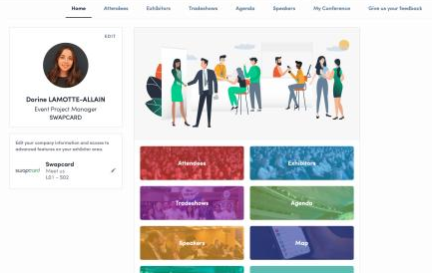
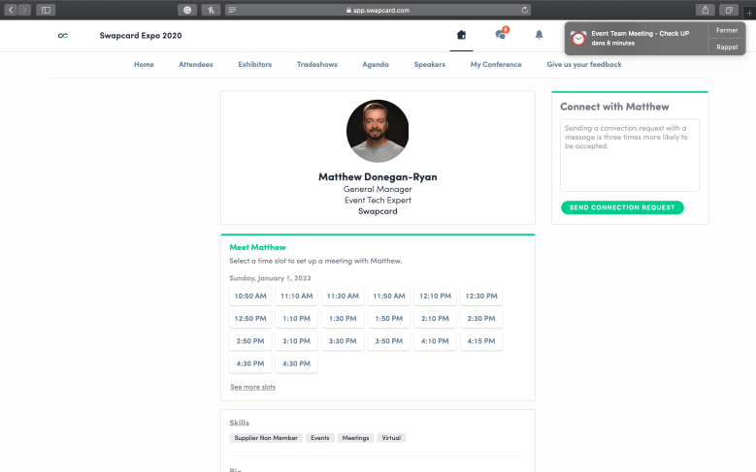
How to network ?
In the home page of the event, you can access to the Speakers and Attendees lists.
Thanks to this, you can identify people of interest. Do not hesitate to contact them through the application to network and schedule ‘face-to-face’ meetings with video calls.
If you see time slots appearing on people's profiles, it means that the organizer has allowed scheduling meetings on the event. Don't loose time and ask for meetings to the people of your choice before all their slots are booked. You can manage your availabilities from the "My Event" section of the application.

Slide 16
How to make a connection request ?
To send a connection request to a person, go to someone’s profile (via the list of participants, speakers, or a company profile) and click on SEND CONNECTION REQUEST.
Tip : We encourage you to write a message before sending your connection request to introduce yourself and explain the reason of your request.
You will be able to find all the people you have been in contact with in the “My Visit” button, in My Contacts tab.

Slide 17
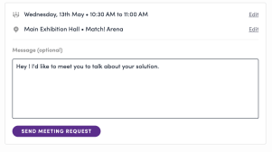
How to request a meeting ?
Step 1 : Go to a person's profile - by going to the list of participants, speakers, or a sponsor’s profile.
Step 2 : Click on one of the suggested meeting slots. If you want to see other slots, click on « see more slots ».
Step 3 : After selecting a slot and the virtual location, write a message to the person you want to meet. Once done, click on « send meeting request ».
Note: If you plan to do a virtual meeting, select Online Meeting when choosing the location.

Slide 18
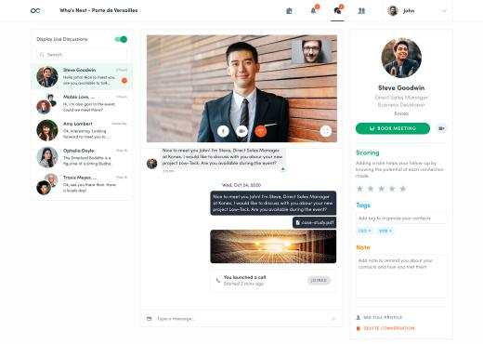
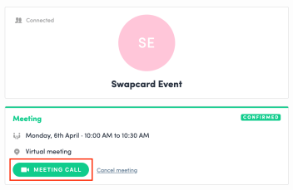
How to do a virtual meeting ?
To do a virtual meeting, you must select the virtual location when requesting a meeting. (See : How to request a meeting?)
A few minutes before the meeting, go to the profile of the participant you have a meeting with, and click on the colored "Meeting call" button that will launch the video call (only available if the meeting is confirmed).

